Slide 1
State Machine + UML Class diagram elements asdfasdfUML UM
Oleksandr Murashchenko, Head of
Advanced Research Department
03.04.2020

Slide 2
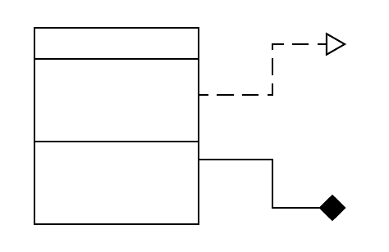
UML class diagram
Class
Attributes
Relationships
Methods

Slide 3
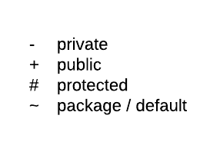
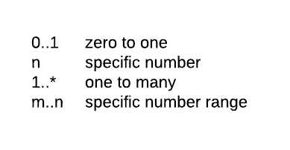
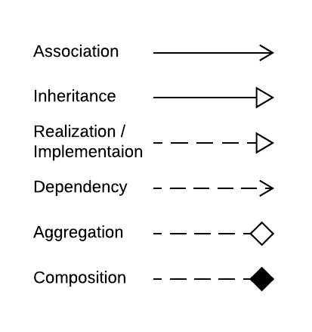
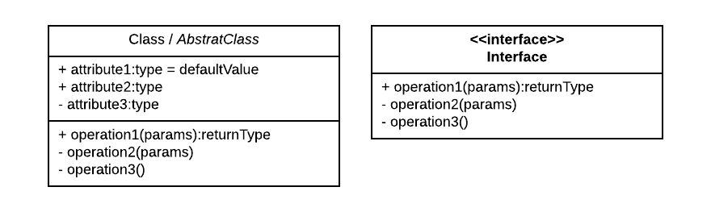
Diagram ElementsxcvbxcvbvbxcvbxcvbUMUUML
Visibility:
Multiplicity:
Ralaltionship Types:
Class Structure

Slide 6
